Slide 1


大数据所面临的挑战问题
-自然&科学文选
马 帅
Notes:
题目：大数据所面临的挑战问题 - 自然&科学文选
摘要：主要根据2011年到2016年期间《自然》和《科学》中的论文，总结分析了大数据（以及相关的社会网络和人工智能）所面临的挑战问题，
主要包括五大类问题：（1）Learning from Limited Data，（2）Learning from Rich Data，（3）Dealing with Noisy and Uncertain Data，（4）Dealing with Networked System Risks，
（5）Dealing with Privacy。

Slide 2

个人简介
北京航空航天大学计算机学院教授、博士生导师；中国计算机学会数据库专业委员会委员，大数据专家委员会委员。
2011年作为海外优秀中青年人才加入北京航空航天大学计算机学院软件开发环境国家重点实验，并特聘为教授。
获得了北京大学(2004)和英国爱丁堡大学 (2011)的两个博士学位。英国爱丁堡大学博士后，并曾在美国贝尔实验室总部实习，在微软亚洲研究院访问。
Homepage: http://mashuai.buaa.edu.cn
Email: mashuai@buaa.edu.cn
Address: Room G1122,
New Main Building,
Beihang University

Slide 3

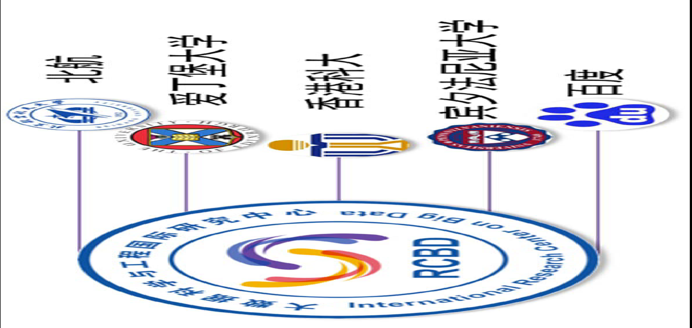
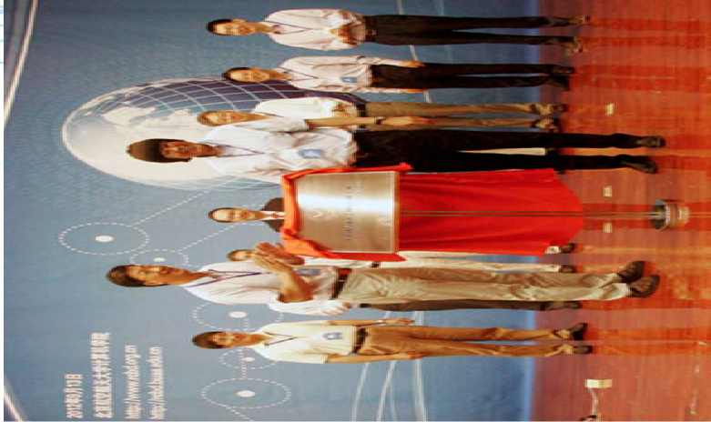
北航大数据科学与工程国际联合研究中心
International Research Centre on Big Data (RCBD)
Founded in September, 2012.
Led by Prof. Wenfei Fan (ACM Fellow, Fellow of the Royal Society of Edinburgh, Scotland) .
Research Topics
Big Data Analysis: Theory and Applications
Data Quality: The Other Side of Big Data
Querying Big Data beyond MapReduce
Querying Big Social Data

Slide 4




国家重点基础研究发展计划
网络信息空间大数据计算的基础研究(2014-2018)
Chief Scientist: Prof. Jinpeng Huai.
8 institutes involved
Focus on “computing theory and practice on Big Data”
http://cnbigdata.org/

Slide 5


北京市大数据科学与脑机智能创新中心
2015年，北京市首批北京高校高精尖创新中心
引领未来数据科学与计算智能的研究与应用方向
加速计算科学、数据科学与脑科学的交叉研究
促进高效智能的下一代计算与数据分析技术创新
通过以数据为中心的智能机器、系统及应用改变未来
Notes:
认定了13个

Slide 6


研究方向与机构设置
瓶颈1：计算的有效性遇到障碍
计算的有效性：
认识数据的内在特征，复杂网络、数学（统计）方法
瓶颈2：能耗成为突出问题
随着规模增大，调度复杂，计算系统功耗问题日益突出
传统存算分离的结构，产生大量的数据搬移开销
传统的计算和存储器件“功耗”不友好
瓶颈3：学习效率和灵活性
学习效率：需要大量的输入数据及标定数据，学习效率低
灵活性：普遍缺乏“类比、联想”等学习功能
数据科学与计算智能
数据工程与
脑机系统
新型计算技术与系统
认知机理与仿真
http://www.bdbc.org.cn/

Slide 7
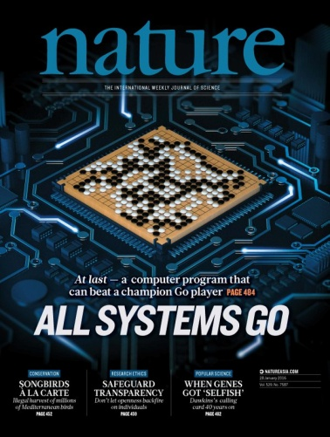
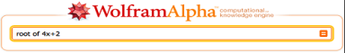
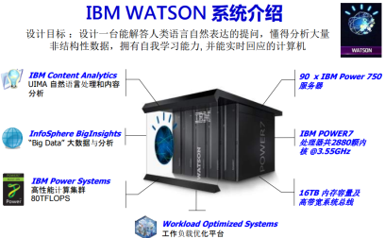
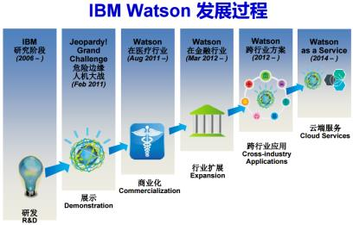
大数据的研究与应用：取得重大突破
过去5年大数据的研究，已经产生了重大突破，并在部分领域取得良好的应用
计算基础：大规模云计算、大规模深度学习
感知处理的角度：大规模深度学习，imageNet
知识组织与管理角度：大规模知识图谱
基于数据产生知识的问答系统与个人辅助系统
Watson DeepQA：智能搜索→知识引擎
Apple Siri & Wolfram Alpha
Watson和Wolfram|Alpha的成功说明：AI可以用一个纯粹的计算系统(交互+计算)实现

Slide 8
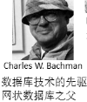
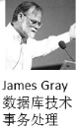


大数据的管理
回顾数据库领域的发展历程
1960s前后，外部存储设备问世，催生数据管理需求，数据库从文件系统中分离出来
1969年，具有完备理论的“关系数据模型”
1981年，事务处理，解决数据一致性问题
2000年以来，数据量持续增大带来的挑战
现代数据库概念和实践
-Ingres(查询改写)
-Postgres(对象关系模型)
-列存储、流处理
Michael Stonebraker
（2014年图灵奖）
具有完备理论的
关系数据模型
Edgar Frank Codd
（1981年图灵奖）
第三代RDBMS
大规模普及
IBM DB2
MS SQL Server
Oracle DB
（80年代后期）
1963
1969
1981
2014
第二代RDBMS:
IBM R系统
Ingres
（70年代）
Oracle DB
（1976）
海量数据存储与处理
GFS, MR, Bigdata
Spark, Impala, …
KV，列存储…
（2008--）
早期：网状数据库
集成数据存储（IDS）
Charles W.Bachman
（1973年图灵奖）
事务处理：解决一 致性与数据恢复问题
James Gray
（1998年图灵奖）

Slide 9
Artificial Intelligence

Slide 10
Social Networks

Slide 11
Big Data

Slide 12
AI + SN + BD

Slide 13
Challenge 1:
Learning from Limited Data

Slide 14
Challenging Aspect1
Ernő Téglás*, Edward Vul, Vittorio Girotto, Michel Gonzalez, Joshua B. Tenenbaum, Luca L. Bonatti, Pure Reasoning in 12-Month-Old Infants as Probabilistic Inference. Science, Vol.332, Issue 6033, pp. 1054-1059, 2011 (research article).
Joshua B. Tenenbaum, Charles Kemp, Thomas L. Griffiths, Noah D. Goodman, How to Grow a Mind: Statistics, Structure, and Abstraction, Science, Vol. 331, Issue 6022, pp. 1279-1285, 2011 (review).
Brenden M. Lake, Ruslan Salakhutdinov, Joshua B. Tenenbaum, Human-level concept learning through probabilistic program induction, Science, Vol. 350, Issue 6266, pp. 1332-1338, 2015 (research article).

Slide 15
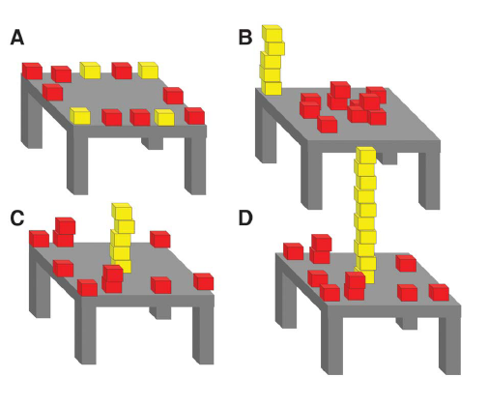
Challenging Aspect1-例1
A Bayesian model of infants’ pure reasoning.
Probe infants’ expectations about unknown future events when they witness dynamic scenes that contain multiple potentially relevant–but also potentially conflicting–sources of information
Infants’ looking times are consistent with a Bayesian ideal observer embodying abstract principles of object motion.
Infants possess surprisingly sophisticated abilities to integrate multiple information sources and abstract knowledge in reasoning about future outcomes.
Ernő Téglás*, Edward Vul, Vittorio Girotto, Michel Gonzalez, Joshua B. Tenenbaum, Luca L. Bonatti, Pure Reasoning in 12-Month-Old Infants as Probabilistic Inference. Science, Vol.332, Issue 6033, pp. 1054-1059, 2011 (research article).

Slide 16
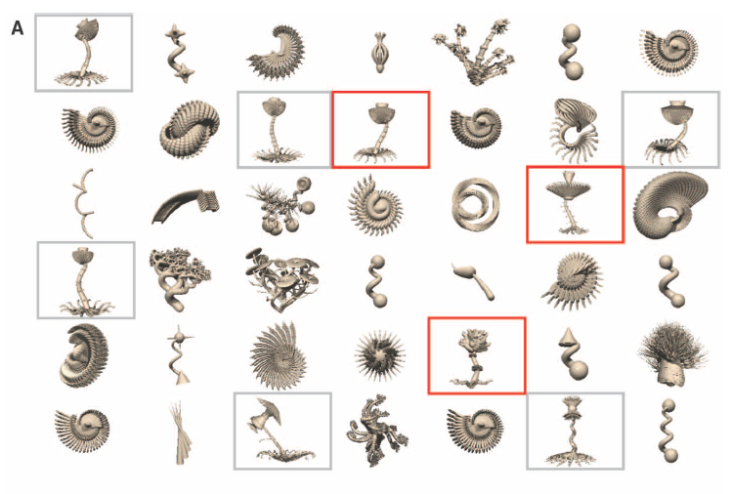
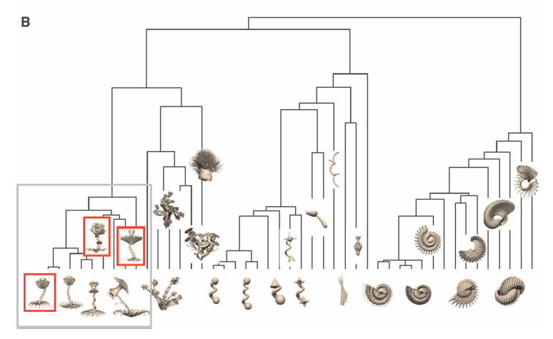
Challenging Aspect1-例2
Learning names for categories can be modeled as Bayesian inference over a tree-structured domain representation
The Form of Abstract Knowledge: a directed graphical model, where nodes represent variables and directed edges between nodes represent probabilistic causal links.
Understanding cognition and its origins in terms of Bayesian inference over richly structured, hierarchical generative models.
Joshua B. Tenenbaum, Charles Kemp, Thomas L. Griffiths, Noah D. Goodman, How to Grow a Mind: Statistics, Structure, and Abstraction, Science, Vol. 331, Issue 6022, pp. 1279-1285, 2011 (review).

Slide 17
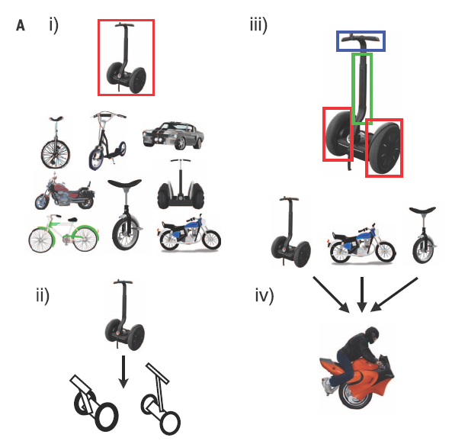
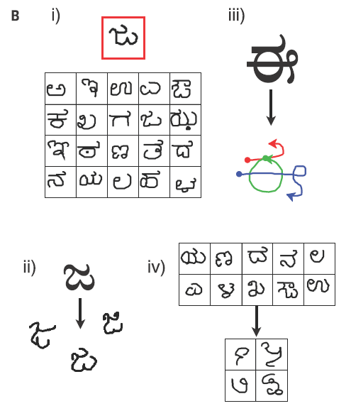
Challenging Aspect1-例3
http://omniglot.com/
People can learn rich concepts from limited data.
A single example of a new concept (red boxes) can be enough information to support
the (i) classification of new examples, (ii) generation of new examples, (iii) parsing an object into parts and relations (parts segmented by color), and (iv) generation of new concepts from related concepts.
Brenden M. Lake, Ruslan Salakhutdinov, Joshua B. Tenenbaum, Human-level concept learning through probabilistic program induction, Science, Vol. 350, Issue 6266, pp. 1332-1338, 2015 (research article).

Slide 18
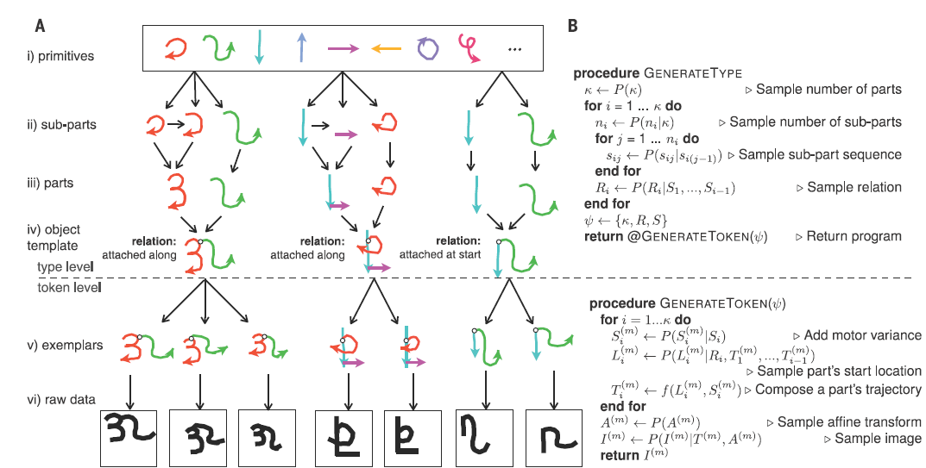
Challenging Aspect1-例3
Propose a computational model (Bayesian Program Learning) that captures these human learning abilities for a large class of simple visual concepts: handwritten characters from the world’s alphabets.
BPL learns simple stochastic programs to represent concepts, building them compositionally from parts, subparts, and spatial relations.
BPL defines a generative model that can sample new types of concepts (an “A,” “B,” etc.) by combining parts and subparts in new ways.

Slide 19
Challenge 2:
Learning from Rich Data

Slide 20
Challenging Aspect2-例4
Michael L. Littman, Reinforcement learning improves behaviour from evaluative feedback, Nature 521, 445–451, 2015 (review).
Google DeepMind, Human-level control through deep reinforcement learning, Nature 518, 529–533, 2015 (letter).
Google DeepMind, Mastering the game of Go with deep neural networks and tree search, Nature 529, pp. 484–489, 2016 (article).
Deep Reinforcement Learning (DRL)
Deep Learning (DL)
Reinforcement Learning (RL)
DRL = DL +RL
Reinforcement learning is the problem of getting an agent to act in the world so as to maximize its rewards. It has to figure out what it did that made it get the reward/punishment, which is known as the credit assignment problem.
Consider teaching a dog a new trick: you cannot tell it what to do, but you can reward/punish it if it does the right/wrong thing.

Slide 21
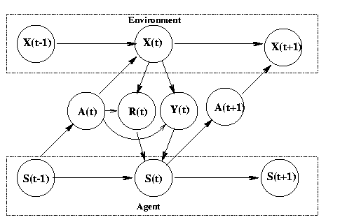
Challenging Aspect2-例4
The environment is a modeled as a stochastic finite state machine with inputs (actions sent from the agent) and outputs (observations and rewards sent to the agent)
The agent is also modelled as stochastic FSM with inputs (observations/rewards sent from the environment) and outputs (actions sent to the environment)
The agent's goal is to find a policy and state-update function so as to maximize the expected sum of discounted rewards
State transition function P(X(t)|X(t-1),A(t))
Observation (output) function P(Y(t) | X(t), A(t))
Reward function E(R(t) | X(t), A(t))
In the special case Y(t)=X(t), we say the world is fully observable, and the model becomes a Markov Decision Process (MDP)
Approximately solve an MDP by replacing the sum over all states with a Monte Carlo approximation
State transition function: S(t) = f (S(t-1), Y(t), R(t), A(t))
Policy/output function: A(t) = pi(S(t)))
Current research topics include: adaptive methods which work with fewer (or no) parameters under a large number of conditions, addressing the exploration problem in large MDPs,
learning and acting under partial information (e.g., using Predictive State Representation),
modular and hierarchical reinforcement learning,
improving existing value-function and policy search methods,
algorithms that work well with large (or continuous) action spaces,
transfer learning, lifelong learning, efficient sample-based planning (e.g., based on Monte-Carlo tree search), and multi-agent or distributed reinforcement Learning
Notes:
If we know the model (i.e., the transition and reward functions), we can solve for the optimal policy in about n^2 time using policy iteration. Unfortunately, if the state is composed of k binary state variables, then n = 2^k, so this is way too slow. In addition, what do we do if we don't know the model?
Reinforcement Learning (RL) solves both problems: we can approximately solve an MDP by replacing the sum over all states with a Monte Carlo approximation. In other words, we only update the V/Q functions (using temporal difference (TD) methods) for states that are actually visited while acting in the world. If we keep track of the transitions made and the rewards received, we can also estimate the model as we go, and then "simulate" the effects of actions without having to actually perform them.
There are three fundamental problems that RL must tackle: the exploration-exploitation tradeoff, the problem of delayed reward (credit assignment), and the need to generalize. We will discuss each in turn.
We mentioned that in RL, the agent must make trajectories through the state space to gather statistics. The exploration-exploitation tradeoff is the following: should we explore new (and potentially more rewarding) states, or stick with what we know to be good (exploit existing knowledge)? This problem has been extensively studied in the case of k-armed bandits, which are MDPs with a single state and k actions. The goal is to choose the optimal action to perform in that state, which is analogous to deciding which of the k levers to pull in a k-armed bandit (slot machine). There are some theoretical results (e.g., Gittins' indices), but they do not generalise to the multi-state case.

Slide 22
Challenge 3:
Dealing with Noisy and Uncertain Data

Slide 23
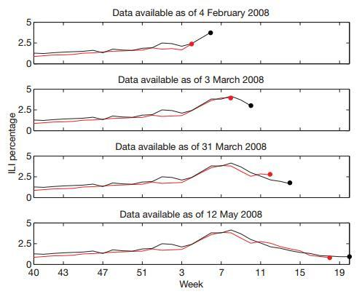
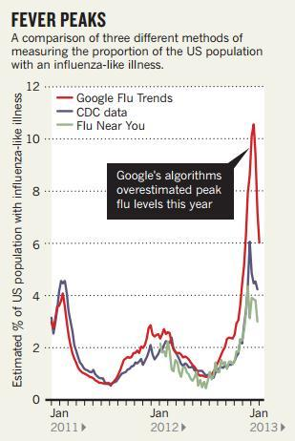
Challenging Aspect3-例5
Ginsberg J, Mohebbi M H, Patel R S, et al. Detecting influenza epidemics using search engine query data. Nature, 2009, 457(7232): 1012-1014 (letter).
Lazer D, Kennedy R, King G, et al. The Parable of Google Flu: Traps in Big Data Analysis. Science, 2014, 343(6176): 1203-1205 (policy forum).

Slide 24
Challenging Aspect3-例5
Ginsberg J, Mohebbi M H, Patel R S, et al. Detecting influenza epidemics using search engine query data. Nature, 2009, 457(7232): 1012-1014 (letter).
Lazer D, Kennedy R, King G, et al. The Parable of Google Flu: Traps in Big Data Analysis. Science, 2014, 343(6176): 1203-1205 (policy forum).
教训：
Big Data Hubris
Algorithm Dynamics
建议：
Transparency and Replicability
Use Big Data to Understand the Unknown
Study the Algorithms
It’s Not Just About Size of the Data.
Notes:
1. 傲娇的大数据（Big Data Hubris ）
意思是说，大家都把大数据作为传统数据收集和分析的“终结者”，而非锦上添花的角色。（原文：Big data are a substitute for, rather than a supplement to, traditional data collection and analysis.）
2. “唯一不变的就是不停在变的”算法（Algorithm Dynamics ）
这种变化包括两个方面：Google工程师的优化，用户使用习惯的进化。（原文：Algorithm dynamics are the changes make by engineers to improve the commercial service and by consumers in using that service.）
1. 【特别地献给Google 】关于数据公开的事儿事儿（Transparency and Replicability ）
经过（靠谱）科研训练（实在是不敢恭维一些科研单位的教学质量）的同学都应该有印象，科学研究的特点之一是可复制，也就是原文的Replicability。
首先，作者们知道Google不可能完全将数据攻来，伦理上也不能被接受（隐私问题）。这件事的亮点在于，即便是有人能够接触到Google的数据，想要重复做一遍Google原来那篇论文的研究也不可能。（原文：Even if one had access to all of Google’s data, it would be impossible to replicate the analyses of the original paper from the information provided regarding the analysis.）
有个东西叫Google Correlate，表面上看（原文：ostensibly，请体会作者们写作时的心情）能够模拟GFT，而实际上是不能的[捂嘴笑]。作者们悻悻地猜测，Google的人大概没觉得有必要遮掩。原文：Clicking the link titled “match the pattern of actual flu activity (this is how we built Google Flu Trends!)” will not, ironically, produce a replication of the GFT search terms. Oddly, the few search terms offered in the papers do not seem to be strongly related with either GFT or the CDC data – we surmise that the authors felt an unarticulated need to cloak the actual search terms identified.
（涉及到另一篇文章： Cook S, Conrad C, Fowlkes A L, et al. Assessing Google flu trends performance in the United States during the 2009 influenza virus A (H1N1) pandemic[J]. PloS one, 2011, 6(8): e23610. ）
2. 大数据有继续揭露未知的潜力（Use Big Data to Understand the Unknown ）
3. 科研人员要关注生产大数据的算法（及变化）（Study the Algorithms ）
4. 不全是“大小” 的事儿（It’s Not Just About Size … of the Data. ）

Slide 25
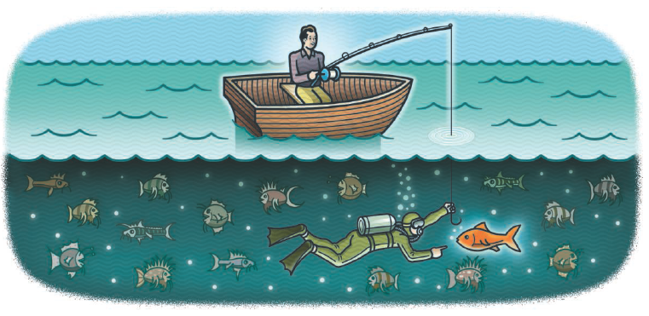
Challenging Aspect3-例6
D. J. Spiegelhalter, The future lies in uncertainty, Science, Vol. 345, Issue 6194, pp. 264-265, 2014 (Perspective).
2013年
The 300th anniversary of Jacob Bernoulli’s Ars Conjectandi, which uses probability theory to explore the properties of statistics as more observations were taken.
The 250th anniversary of Thomas Bayes’ essay on how humans can sequentially learn from experience, steadily updating their beliefs as more data become available.
Notes:
1. 傲娇的大数据（Big Data Hubris ）
意思是说，大家都把大数据作为传统数据收集和分析的“终结者”，而非锦上添花的角色。（原文：Big data are a substitute for, rather than a supplement to, traditional data collection and analysis.）
2. “唯一不变的就是不停在变的”算法（Algorithm Dynamics ）
这种变化包括两个方面：Google工程师的优化，用户使用习惯的进化。（原文：Algorithm dynamics are the changes make by engineers to improve the commercial service and by consumers in using that service.）
1. 【特别地献给Google 】关于数据公开的事儿事儿（Transparency and Replicability ）
经过（靠谱）科研训练（实在是不敢恭维一些科研单位的教学质量）的同学都应该有印象，科学研究的特点之一是可复制，也就是原文的Replicability。
首先，作者们知道Google不可能完全将数据攻来，伦理上也不能被接受（隐私问题）。这件事的亮点在于，即便是有人能够接触到Google的数据，想要重复做一遍Google原来那篇论文的研究也不可能。（原文：Even if one had access to all of Google’s data, it would be impossible to replicate the analyses of the original paper from the information provided regarding the analysis.）
有个东西叫Google Correlate，表面上看（原文：ostensibly，请体会作者们写作时的心情）能够模拟GFT，而实际上是不能的[捂嘴笑]。作者们悻悻地猜测，Google的人大概没觉得有必要遮掩。原文：Clicking the link titled “match the pattern of actual flu activity (this is how we built Google Flu Trends!)” will not, ironically, produce a replication of the GFT search terms. Oddly, the few search terms offered in the papers do not seem to be strongly related with either GFT or the CDC data – we surmise that the authors felt an unarticulated need to cloak the actual search terms identified.
（涉及到另一篇文章： Cook S, Conrad C, Fowlkes A L, et al. Assessing Google flu trends performance in the United States during the 2009 influenza virus A (H1N1) pandemic[J]. PloS one, 2011, 6(8): e23610. ）
2. 大数据有继续揭露未知的潜力（Use Big Data to Understand the Unknown ）
3. 科研人员要关注生产大数据的算法（及变化）（Study the Algorithms ）
4. 不全是“大小” 的事儿（It’s Not Just About Size … of the Data. ）

Slide 26
Negative Aspect3-例6
Traditional Statistical Problems ：large n, small p
many observations (n), such as participants in a clinical trial,
but few parameters were measured (p), and just a handful of hypotheses tested.
Current statistical problems ：small n, large p
The expression of tens of thousands of genes in a limited number of tissue samples.
Future statistical problems ：large n, large p
Images, genomes, and electronic health records become linked together.
Big Data means that we can get more precise answers;
Bernoulli proved when he showed how the variability in an estimate goes down as the sample size increases.
This apparent precision will delude us
if issues such as selection bias, regression to the mean, multiple testing, and over interpretation of associations as causation are not properly taken into account.
As data sets get larger, these problems get worse, because the complexity and number of potential false findings grow exponentially.
Serious statistical skill is required to avoid being misled.
Notes:
Traditional statistical problems could be
termed “large n, small p”: There were many
observations (n), such as participants in a
clinical trial, but few parameters were measured
(p), and just a handful of hypotheses
tested.

Slide 27
Challenging Aspect3-例7
Derek Ruths, Jürgen Pfeffer, Social media for large studies of behavior, Science, Vol. 346, Issue 6213, pp. 1063-1064, 2014 (POLICY FORUM).
Large-scale studies of human behavior in social media need to be held to higher methodological standards
On 3 November 1948, the day after Harry Truman won the United States presidential elections, the Chicago Tribune published one of the most famous erroneous headlines in newspaper history: “Dewey Defeats Truman”
REPRESENTATION OF HUMAN POPULATIONS.
Population bias, Proprietary algorithms for public data.
REPRESENTATION OF HUMAN BEHAVIOR.
Human behavior and online platform design
Distortion of human behavior, Nonhumans in large-scale studies.
ISSUES WITH METHODS.
Proxy population mismatch, Incomparability of methods and data.
Multiple comparison problems, Multiple hypothesis testing.
Notes:
For example, the highest-volume source of public
Twitter data, which are used by thousands
of researchers worldwide, is not an
accurate representation of the overall platform’s
data ( 11).
Multiple comparison problems. The body
of social media analysis that concerns the development
of user/content classification and
prediction has unaddressed issues with overfitting.

Slide 28
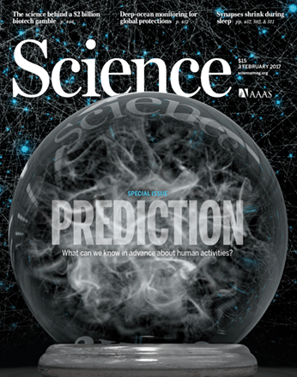

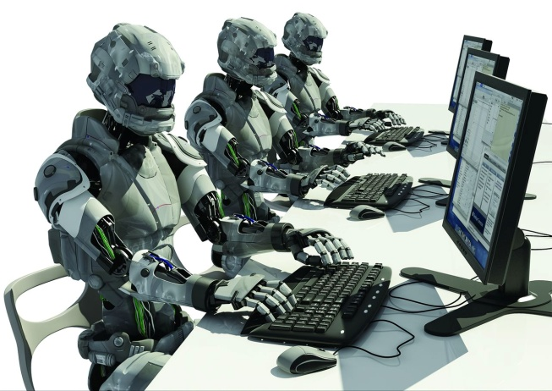
Challenging Aspect3-例8
Prediction is now a developing science
Success seems to be achieved most consistently when questions are tackled in multidisciplinary efforts that join human understanding of context with algorithmic capacity to handle terabytes of data - Special Issue: Prediction, Science, Feb. 3, 2017.
2016年美国大选预测失败原因？
Twitter机器人、雇佣军
Shy Trump voter理论: 支持者趋向于保持沉默
人类行为预测是下一个前沿：
更多的数据≠更好的预测：噪音的存在
罕见事件、行为动态变化
IoT的涌现导致多种异构数据爆炸
Notes:
预测是一门发展中的科学，需要均衡机器学习等人工智能方法和人的因素

Slide 29
Challenge 4:
Dealing with Networked System Risks

Slide 30
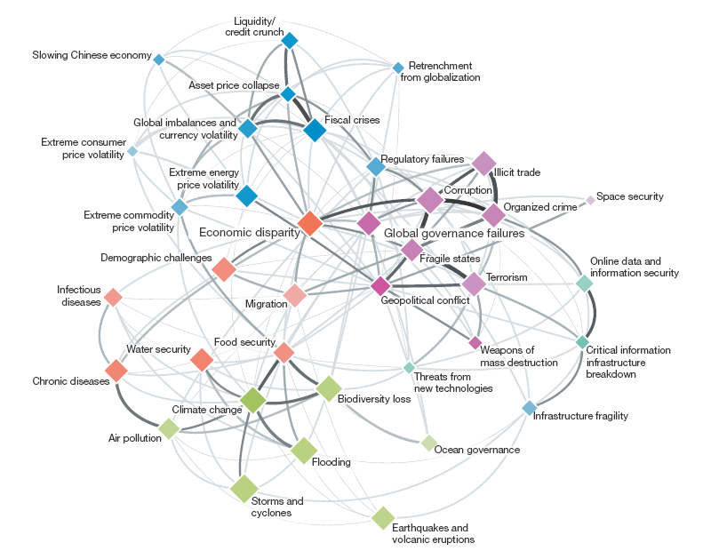
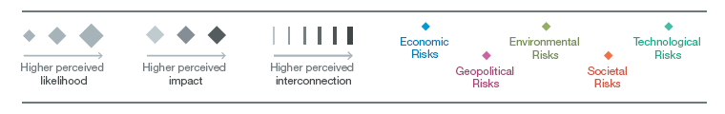
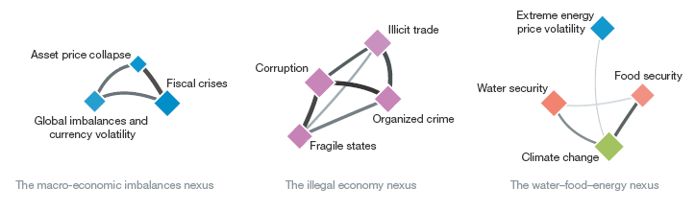
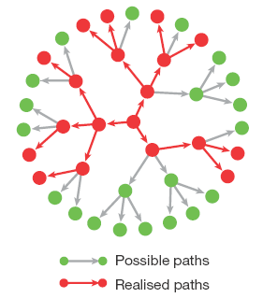
Challenging Aspect4-例9
Dirk Helbing, Globally networked risks and how to respond, Nature , vol. 497, pp.51–59 , 2013 (Perspective).
Time Bomb?.
According to the standard ISO 31000, risk is defined as ‘‘effect of uncertainty on objectives’’.
Often quantified as the probability of occurrence of an (adverse) event, times its (negative) impact (damage), but may also create positive impacts, such as opportunities for stakeholders.
The author argues that systemic failures and extreme events are consequences of the highly interconnected systems and networked risks humans have created.
Notes:
Traditional statistical problems could be
termed “large n, small p”: There were many
observations (n), such as participants in a
clinical trial, but few parameters were measured
(p), and just a handful of hypotheses
tested.

Slide 31
Challenge 5:
Dealing with Privacy

Slide 32
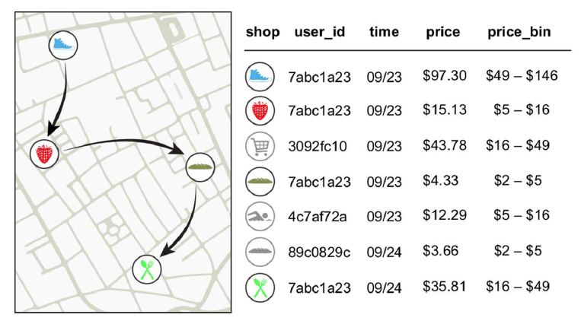
Challenging Aspect5-例10
Yves-Alexandre de Montjoye, Laura Radaelli, Vivek Kumar Singh, Alex Pentland, Unique in the shopping mall: On the reidentifiability of credit card metadata,Science, Vol. 347, Issue 6221, pp. 536-539, 2015 (report).
Financial traces in a simply anonymized data set such as the one we use for this work.
Arrows represent the temporal sequence of transactions for user 7abc1a23..
Notes:
Traditional statistical problems could be
termed “large n, small p”: There were many
observations (n), such as participants in a
clinical trial, but few parameters were measured
(p), and just a handful of hypotheses
tested.

Slide 33
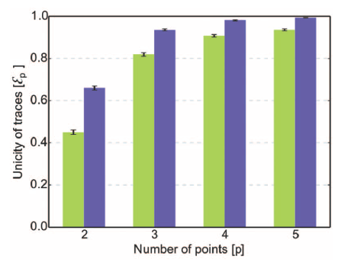
Challenging Aspect5-例10
Yves-Alexandre de Montjoye, Laura Radaelli Vivek Kumar Singh, Alex Pentland, Unique in the shopping mall: On the reidentifiability of credit card metadata, Science, Vol. 347, Issue 6221, pp. 536-539, 2015 (report).
The unicity of the credit card data set given p points.
The green bars represent unicity when spatio-temporal tuples are known.
The blue bars represent unicity when using spatial-temporal-price triples
Large-scale data sets of human behavior have the potential to fundamentally transform the way we fight diseases, design cities, or perform research. Metadata, however, contain sensitive information.
We study 3 months of credit card records for 1.1 million people and show that four spatiotemporal points are enough to uniquely reidentify 90% of individuals.
Notes:
Traditional statistical problems could be
termed “large n, small p”: There were many
observations (n), such as participants in a
clinical trial, but few parameters were measured
(p), and just a handful of hypotheses
tested.

Slide 34
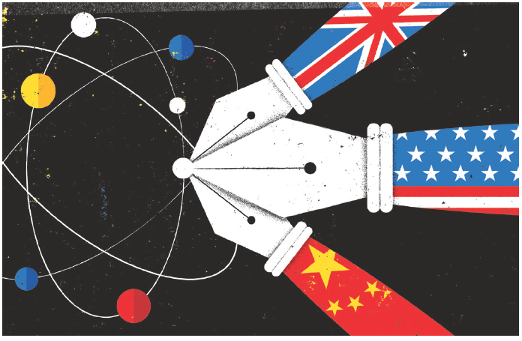
The Fourth Age of Research
Jonathan Adams analyses papers from the past three decades and finds that the best science comes from international collaboration.– Nature vol 497, pp 560, 2013 (comment).
Notes:
the individual, the institutional，and the national.

Slide 35
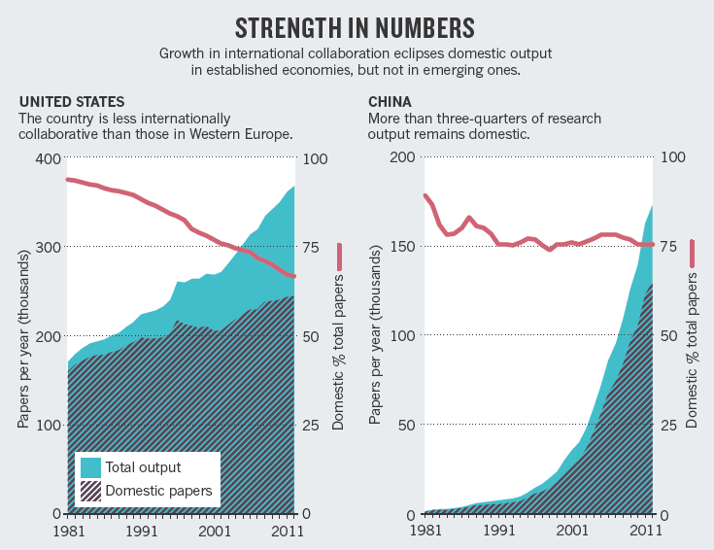
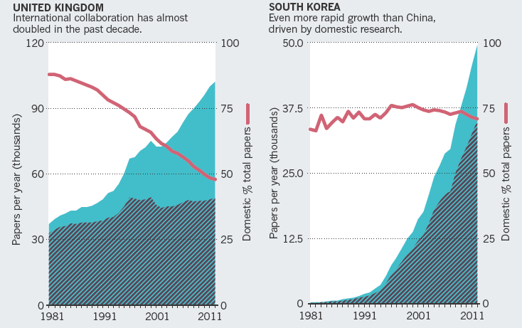
The Fourth Age of Research
Notes:
Jonathan Adams was formerly director of research evaluation at Thomson Reuters and is now a research-management consultant in Leeds, UK.
e-mail: jonathanzadams@gmail.com

Slide 36
Homepage: http://mashuai.buaa.edu.cn
Email: mashuai@buaa.edu.cn
Address: Room G1122,
New Main Building,
Beihang University
VBeijing, China

